Slide 1

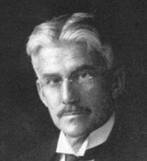
Light, Color and Imaging

Slide 2
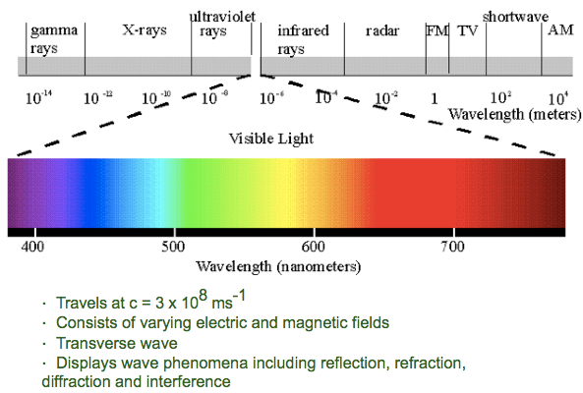
Light
The Electromagnetic Spectrum:
E = hν

Slide 3
Light ➔Color
When light impinges on a surface, lots of things can happen:
e- of the atoms absorb some of the photons
Followed by possible vibrational relaxations in excited states
Followed by possible intersystem crossing
Followed by possible radiative decay (fluorescence or phosphorescence)
This produces color if v_{emitted} = {400nm, 700nm}
Combinations of all of the above

Slide 4
Light ➔Color
When light impinges on a surface, lots of things can happen:
e- of the atoms don’t absorb all of the photons
There are no available states for the e- to be excited to
These are reflected photons
Reflected photons with v_{i} = {400nm, 700nm} produce most of the colors we see!
White light
Reflects mostly greens that our eyes are sensitive to
Absorbs reds, blues

Slide 5
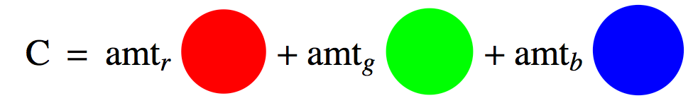
Color
So what we call color is just a bunch of hv_{i} coming from a material (reflected or emitted) which have v_{i} = {400nm, 700nm}
Grassmann’s law: the color of a test light can be matched by an additive mixture of three primary lights
The primaries are references and can be anything.
Common primaries:
Red (700nm), Green (546.1nm), Blue (435.8nm)
So a specific color, C would be:

Slide 6
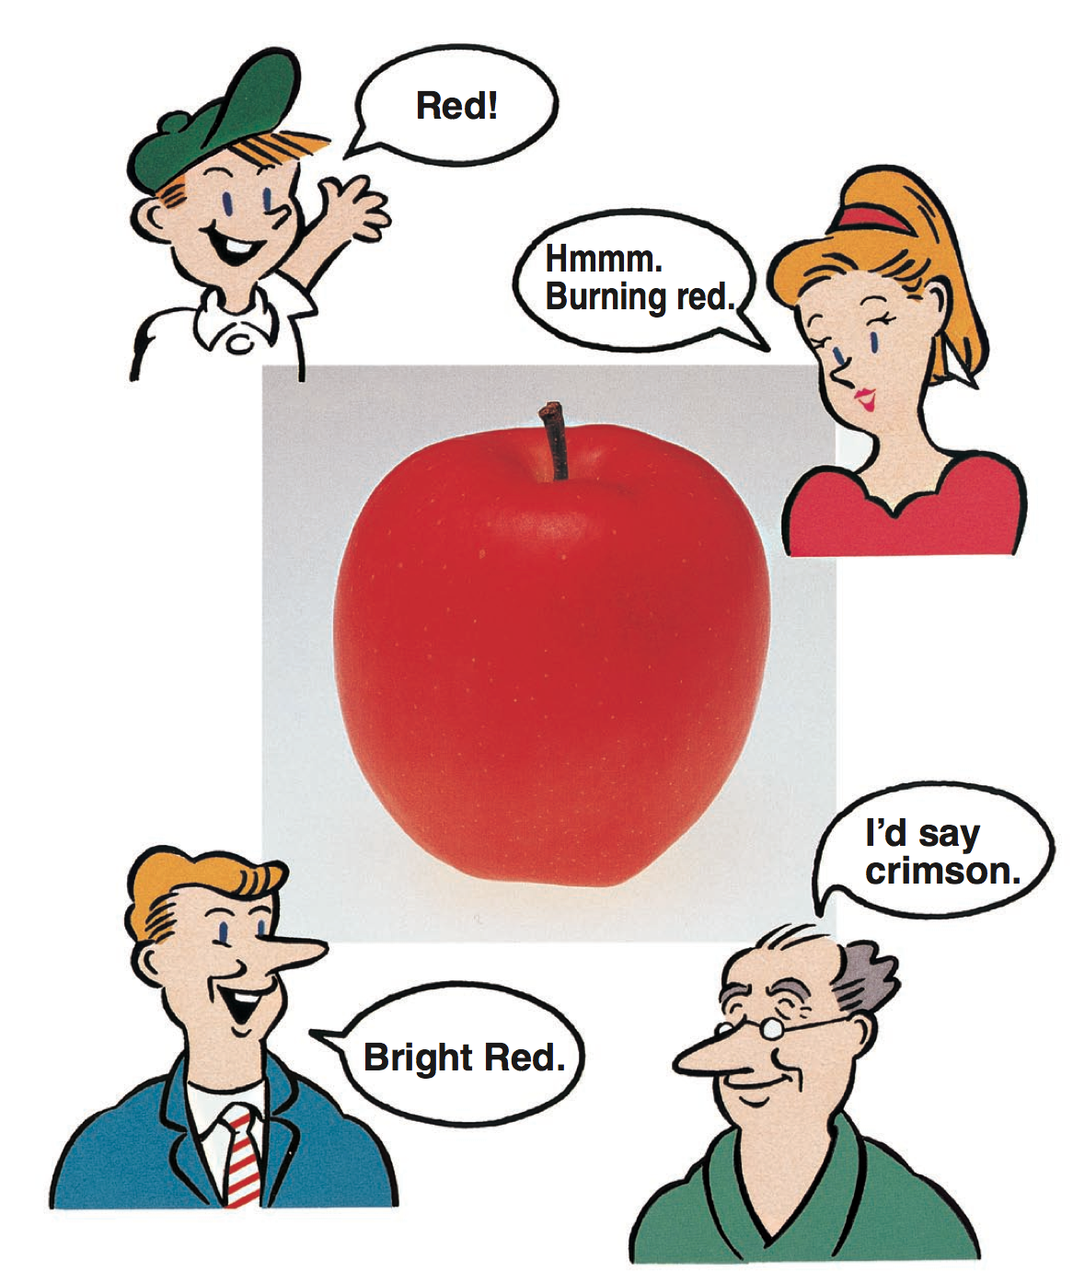
What Color Is It?
A great reference: Konica-Minolta, Precise Color Communication:
http://www.konicaminolta.com/instruments/knowledge/color/

Slide 7
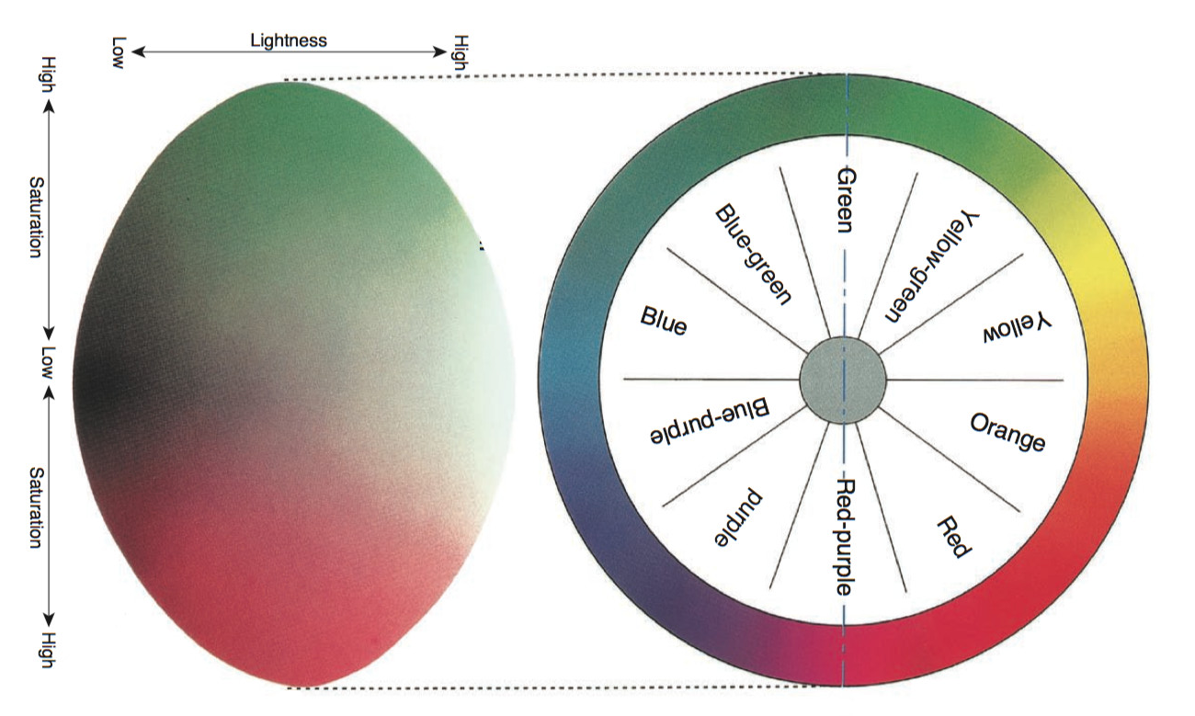
Munsell System
Hue: Basic “color” name
Luminosity, Lightness, Value: perceived brightness/darkness
Saturation, Chroma: Vividness/Dullness
Lightness
Hue
Saturation
Konica-Minolta

Slide 8
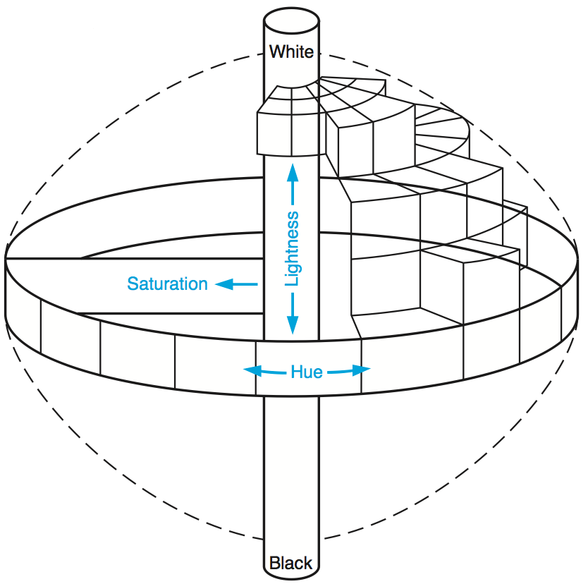
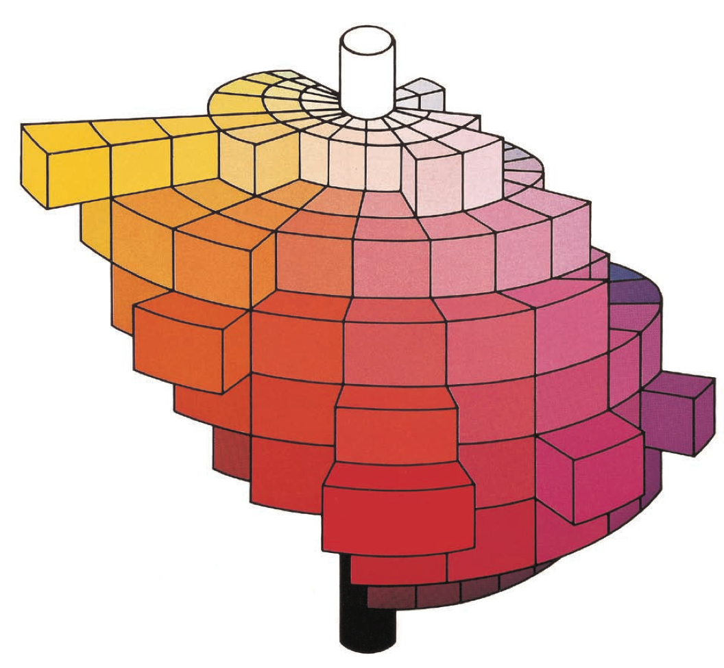
Munsell System
Konica-Minolta

Slide 9
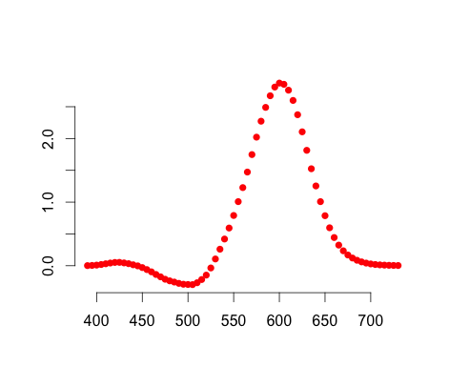
Standardization of Color
Commission Internationale de L'éclairag (CIE) 1931 color matching functions:
Test light of wavelength λ=550 nm
Ask a set of people:
How much Red (700nm) do you need?
Well, I need to dial in this much Red (700nm)
To match a test light of this λ…
λ of test light

Slide 10
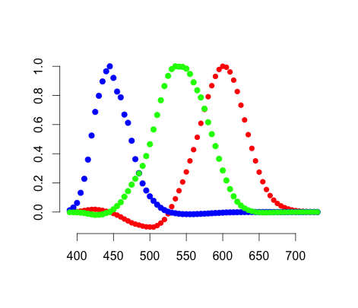
Standardization of Color
Commission Internationale de L'éclairag (CIE) 1931 color matching functions:
Test light of wavelength λ=550 nm
Ask a set of people:
How much Green (546.1nm) do you need?
Well, I need to dial in this much Green (546.1nm)
To match a test light of this λ…
λ of test light

Slide 11
Standardization of Color
Commission Internationale de L'éclairag (CIE) 1931 color matching functions:
Test light of wavelength λ=550 nm
Ask a set of people:
How much Blue (435.8nm) do you need?
Well, I need to dial in this much Blue (435.8nm)
To match a test light of this λ…
λ of test light

Slide 12
Standardization of Color
Commission Internationale de L'éclairag (CIE) 1931 color matching functions:
b(λ)
g(λ)
r(λ)
Scaled “Amount” Units
So some of the colors are negative??
λ of test light

Slide 13
Standardization of Color
Rescaling each of the color matching functions to their relative luminescence gives the RBG tri-stimulus values

Slide 14
Standardization of Color
Color coordinates can be a bit difficult to visualize in a 3D volume, so well reduce the color space dimention to 2D with the trick:
rgb-chromaticity coordinates
Since r-g-b sum to 1 we can work with two out of three.
Usually we pick (r,g)

Slide 15
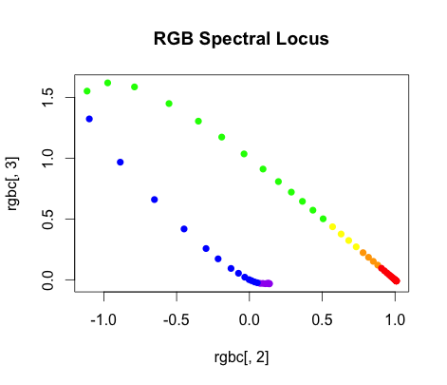
Standardization of Color
Another representation of the RGB color matching functions:
Plot r(λ) vs. g(λ): rg-chromaticity diagram
(0,1): λ=546.1 nm
All colors within the locus are mixtures of spectral (monochromatic) colors
G
Test lights in this
quadrant required
some “negative” amount
of one of the primaries
(1,0): λ=700 nm
(0,0): λ=435.8 nm
B
R

Slide 16
Standardization of Color
All colors along a line connecting any two points can be made by mixing proportional amounts (p and 1-p) of the colors at the ends
x₁
x₃
x₂
x₁
x₁
x₃
x₃
x₂
x₂

Slide 17
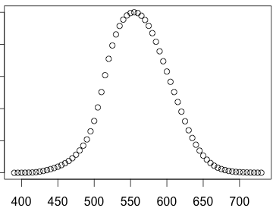
Standardization of Color
A new set of “primaries” so all “colors” are positive quantities:
The “luminescence” function V(λ) will be the new color matching function y(λ):
luminescence
λ of test light

Slide 18
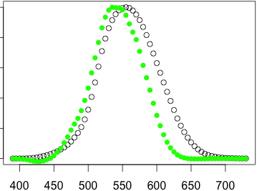
Standardization of Color
A new set of “primaries” so all “colors” are positive quantities:
The “luminescence” function will be the new color matching function y(λ)
g(λ)
y(λ)
y(λ) ≈ 0.18 r(λ) + 0.81 g(λ) + 0.01 b(λ)
λ of test light

Slide 19
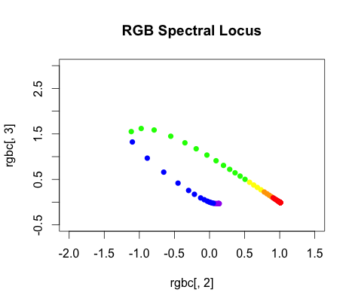
Standardization of Color
A new set of “primaries” so all “colors” are positive quantities:
CIE 1931 standard: Draw in a new triangle
Y
Just need to clear this point
Line just outside the spectral locus
Z
Alychne: luminescence = 0 line
X

Slide 20
Standardization of Color
Transformation to go from RGB space to XYZ space:

Slide 21
Standardization of Color
To go from rgb to xyz it’s a little ugly-ier.
Most of this complication is to force y(λ) = V(λ) instead of y(λ) ≈ V(λ)

Slide 22
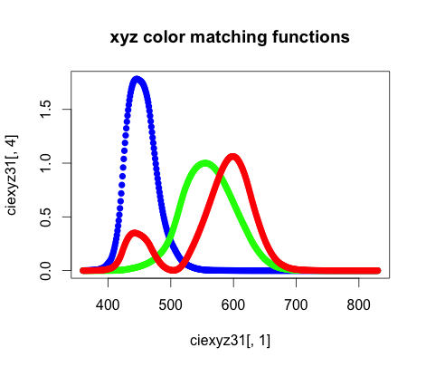
Standardization of Color
A new set of “primaries” so all “colors” are positive quantities:
CIE 1931 standard: Make X, Y, and Z the new primaries
Leads to the new color matching functions:
z(λ)
y(λ)
x(λ)
λ of test light

Slide 23
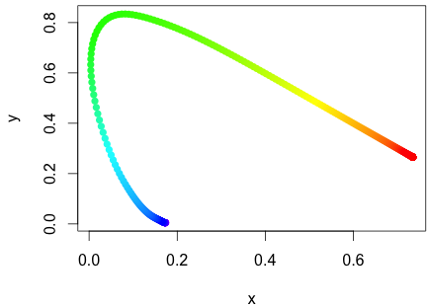
Standardization of Color
A new set of “primaries” so all “colors” are positive quantities:
CIE 1931 standard: xy-Chromaticity coordinates (xyY system)
Visible spectral locus

Slide 24
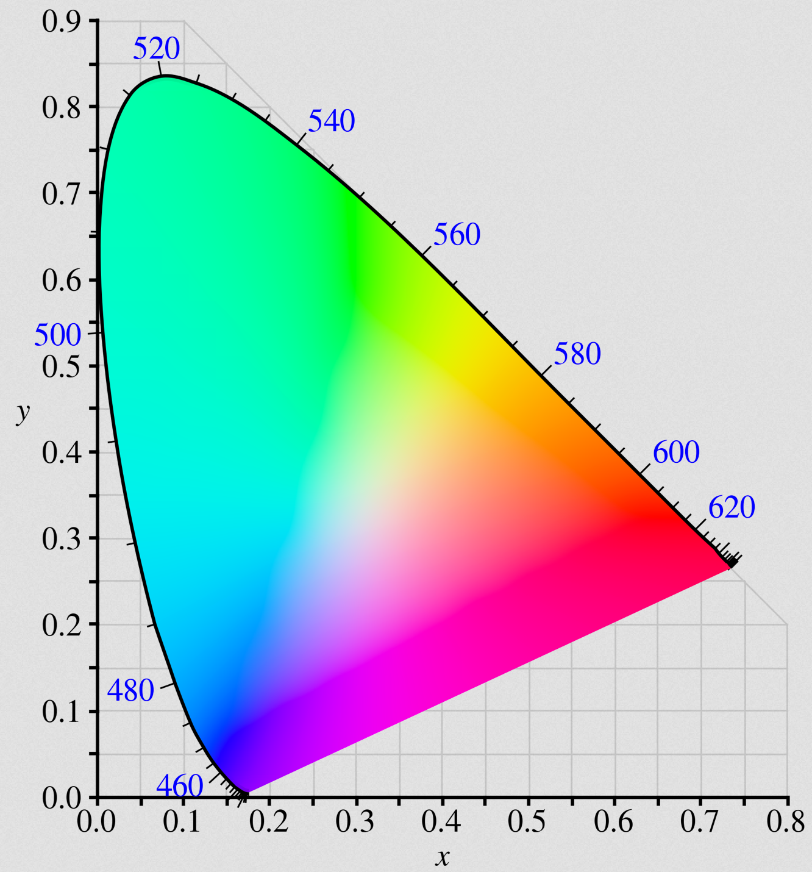
Standardization of Color
A new set of “primaries” so all “colors” are positive quantities:
The full visible Gamut
The Gamut is a convex hull.
Every point on the inside is a linear combination of points on the visible locus
Wikipedia

Slide 25
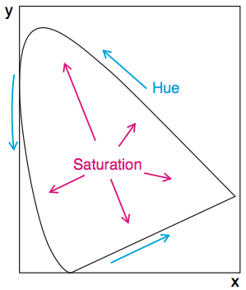
Munsell Descriptors and the Gamut
Konica-Minolta
Every x,y point in the Gamut corresponds to a set of brightness's Y

Slide 26
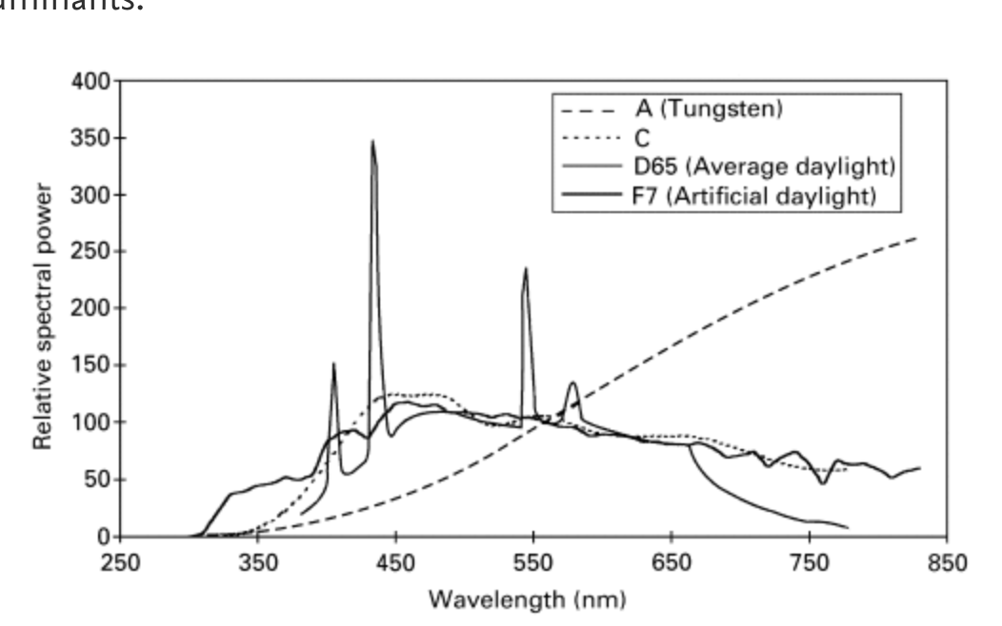
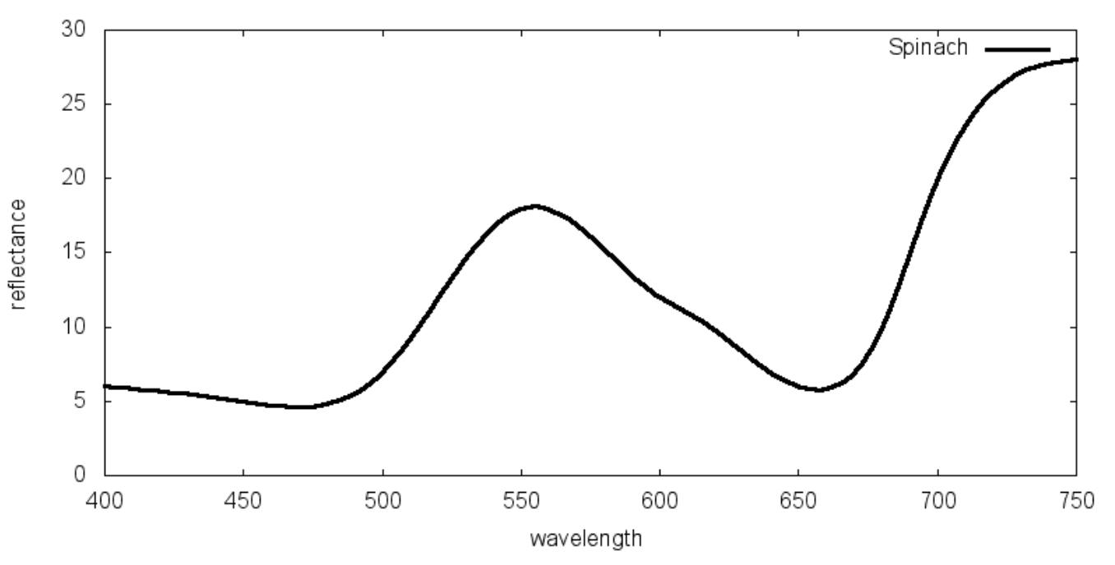
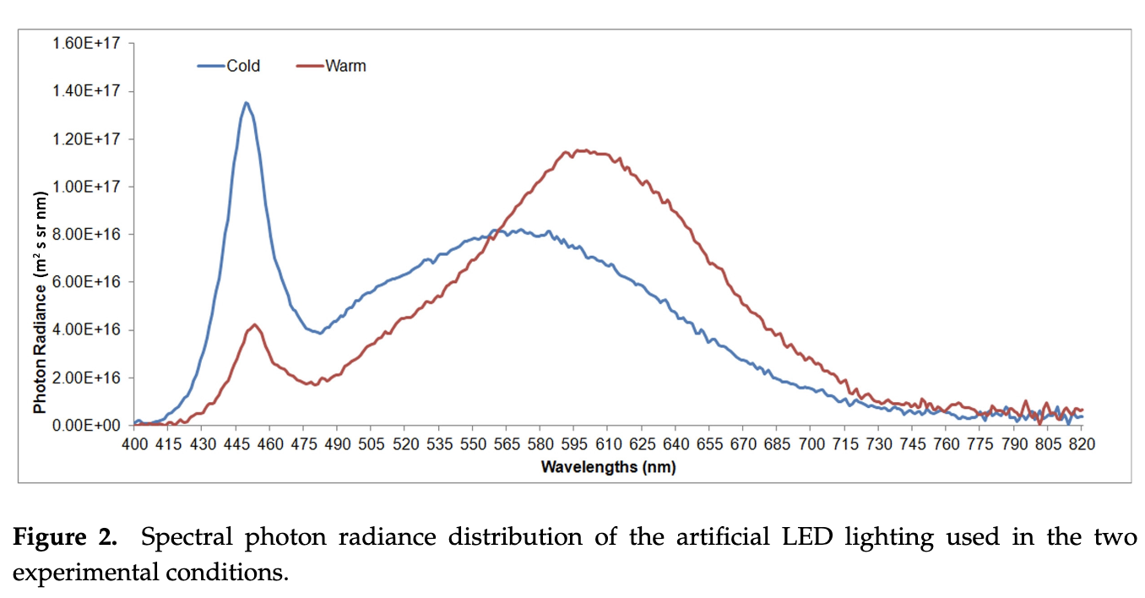
Spectral Power Distribution
Color of a complex object illuminated by some continuous wavelength source is determined by the energy intensity it “gives off” (emits or reflects)
Called the object’s spectral power distribution (SPD): S(λ)
S(λ) is a complicated function that usually has to be determined experimentally
Dictated by quantum mechanics and physical structure of the material at the atomic/molecular scale
Spinach illuminated by the sun
Gilchrist et al. 2017
Abraham et al.? 2016
Burattini et al. 2017

Slide 27
Spectral Power Distribution
A complex object’s color coordinates are determined by:

Slide 28
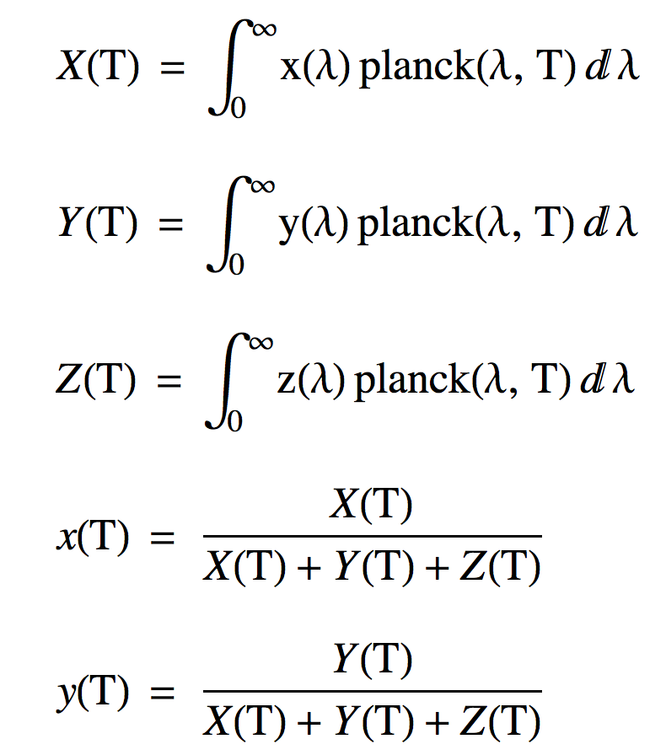
The Planckian Locus
Black bodies give off an energy intensity so they are SPDs.
What color are they at a given temperature?
Project the Planck distribution at a given temperature onto the x, y and z color matching functions!

Slide 29
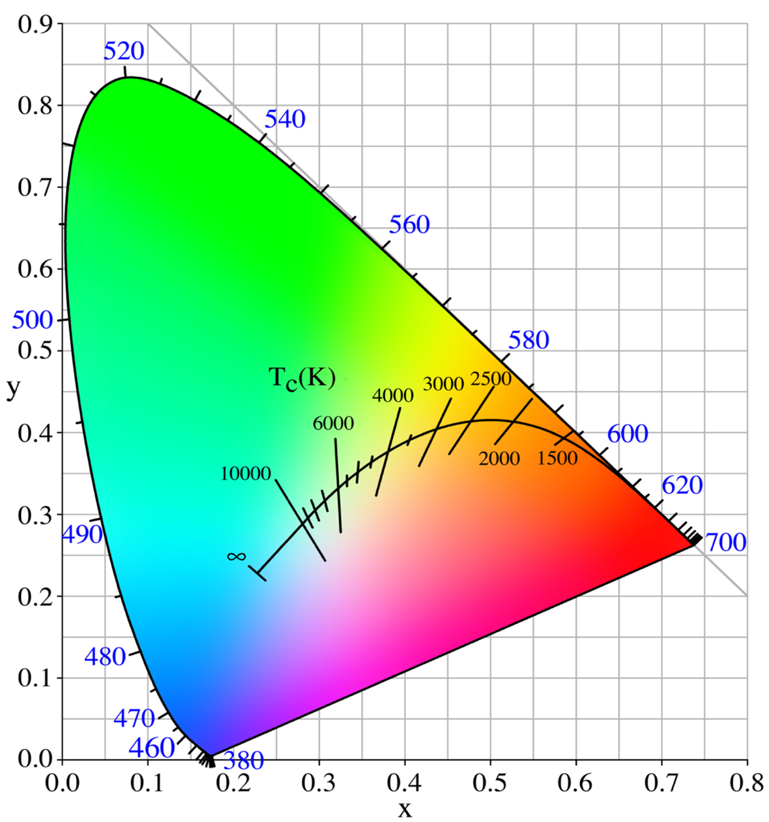
The Planckian Locus
Color Temperature
Plot the curve of x(T), y(T) on the Gamut
White point
Chromaticity coordinates of an illuminant with a spectral range that simulates different kinds of “whites”
A: Indoor lighting
B,C: Sim. sunlight
D: “Natural” daylight
D₆₅, D₅₀
E equal energy white point
x=1/3, y=1/3
G_{546.1}
E
R₇₀₀
B_{435.8}
Wikipedia

Slide 30
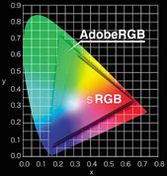
Standard Gamuts for RGB
Olympus

Slide 31
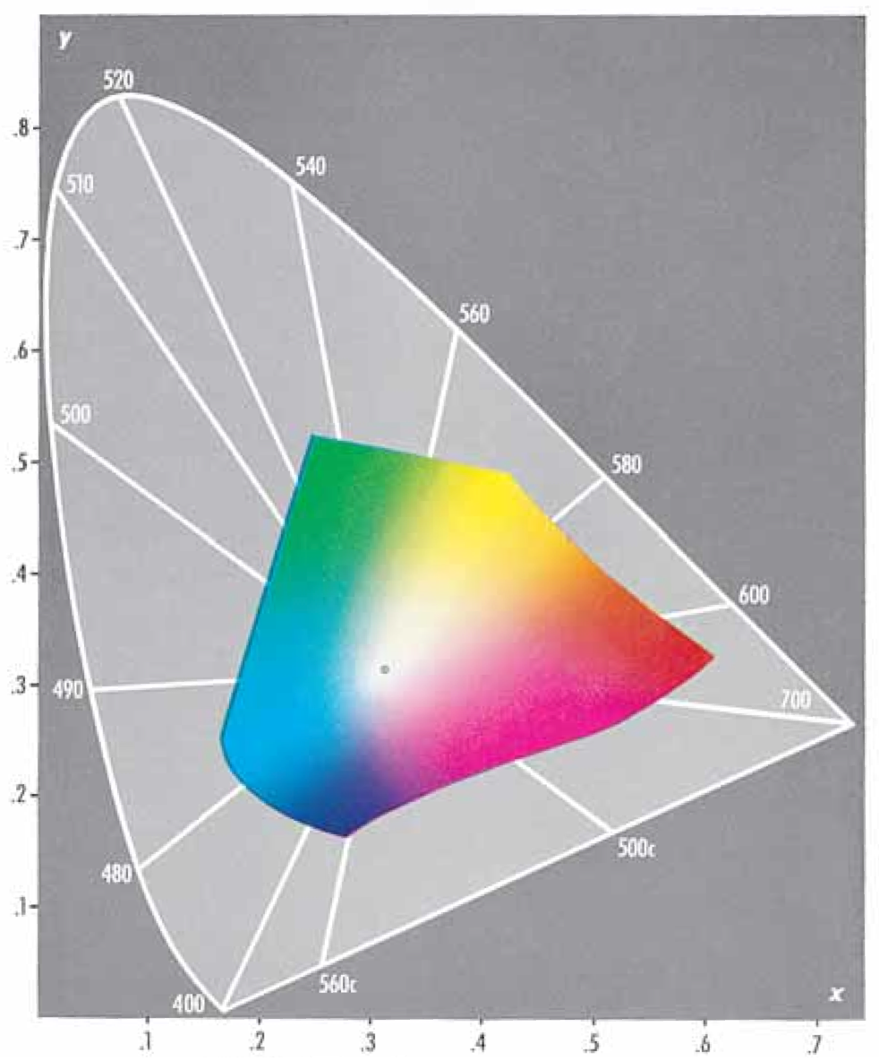
Gamut of Printed Inks
Kodak 1996

Slide 32

Peter V Tytell
Peter contributed endless to Forensic Science, and inspired these lectures

